Slide 1

Chapter 23
Process-to-Process Delivery:
UDP, TCP, and SCTP
23.<number>
Copyright © The McGraw-Hill Companies, Inc. Permission required for reproduction or display.

Slide 2
23-1 PROCESS-TO-PROCESS DELIVERY
The transport layer is responsible for process-to-process delivery—the delivery of a packet, part of a message, from one process to another. Two processes communicate in a client/server relationship, as we will see later.
Topics discussed in this Lecture:
Client/Server Paradigm
Multiplexing and Demultiplexing
Connectionless Versus Connection-Oriented Service
Reliable Versus Unreliable
Three Protocols
23.<number>

Slide 3

Note
The transport layer is responsible for process-to-process delivery.
23.<number>

Slide 4
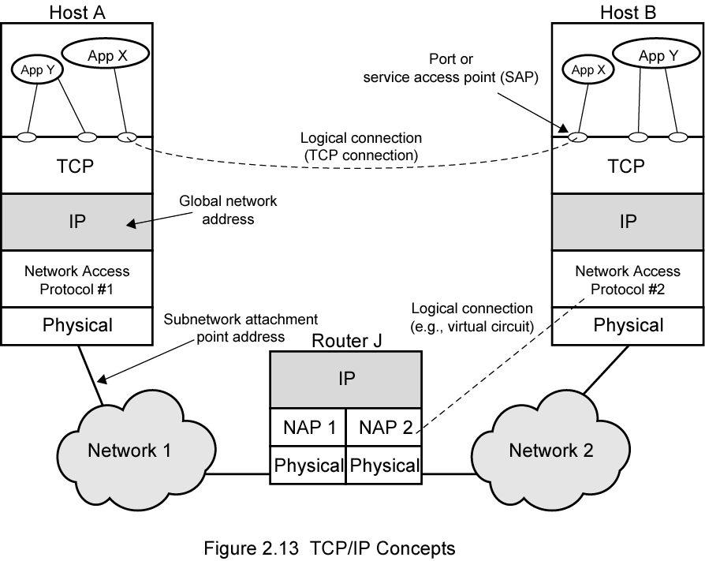
TCP/IP Concepts

Slide 5

Figure 23.1 Types of data deliveries
23.<number>

Slide 6

Figure 23.2 Port numbers
23.<number>

Slide 7

Figure 23.3 IP addresses versus port numbers
23.<number>

Slide 8
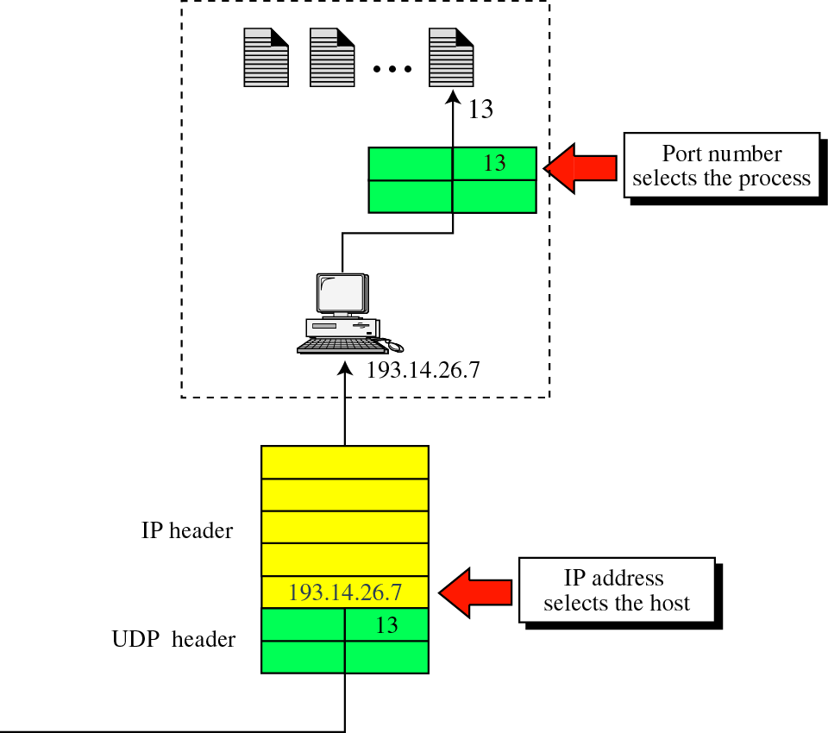
Figure 11-4
IP addresses versus port numbers

Slide 9

Figure 23.4 Internet Assigned Numbers Authority ranges
23.<number>

Slide 10

Figure 23.5 Socket address
23.<number>

Slide 11

Figure 23.6 Multiplexing and demultiplexing
23.<number>

Slide 12

Figure 23.7 Error control
23.<number>

Slide 13

Figure 23.8 Position of UDP, TCP, and Stream Control TP in TCP/IP suite
23.<number>

Slide 14
23-2 USER DATAGRAM PROTOCOL (UDP)
The User Datagram Protocol (UDP) is called a connectionless, unreliable transport protocol. It does not add anything to the services of IP except to provide process-to-process communication instead of host-to-host communication.
Topics discussed in this section:
Well-Known Ports for UDP
User Datagram
Checksum
UDP Operation
Use of UDP
23.<number>

Slide 15


Table 23.1 Well-known ports used with UDP
23.<number>

Slide 16

Example 23.1
In UNIX, the well-known ports are stored in a file called /etc/services. Each line in this file gives the name of the server and the well-known port number. We can use the
grep utility to extract the line corresponding to the desired application. The following shows the port for FTP. Note that FTP can use port 21 with either UDP or TCP.
23.<number>

Slide 17

Example 23.1 (continued)
SNMP uses two port numbers (161 and 162), each for a different purpose.
23.<number>

Slide 18

Figure 23.9 User datagram format
23.<number>

Slide 19
Note
UDP length
= IP length – IP header’s length
23.<number>

Slide 20

Figure 23.10 Pseudoheader for checksum calculation
23.<number>

Slide 21
Example 23.2
Figure 23.11 shows the checksum calculation for a very small user datagram with only 7 bytes of data. Because the number of bytes of data is odd, padding is added for checksum calculation. The pseudoheader as well as the padding will be dropped when the user datagram is delivered to IP.
23.<number>

Slide 22

Figure 23.11 Checksum calculation of a simple UDP user datagram
23.<number>

Slide 23
Example 23.2.1
Show the entries for the header of a UDP user datagram that carries a message from a TFTP client to a TFTP server. Fill the checksum with 0s. Choose an appropriate ephemeral port number and the correct well-known port number. The length of data is 40 bytes. Show the UDP packet format.
22.<number>

Slide 24
Example 23.2.2
A client has a packet of 68000 bytes, can this packet be transferred by a single UDP datagram?
22.<number>

Slide 25
Example 23.2.3
A UDP header in hexadecimal format
06 32 00 0D 00 1C E2 17
What is the source port number?
What is the destination port number?
What is the total length of the user datagram?
What is the length of the data?
Is packet directed from a client to server or vice versa?
What is the client process?
22.<number>

Slide 26

Figure 23.12 Queues in UDP
23.<number>

Slide 27
23-3 TCP
TCP is a connection-oriented protocol; it creates a virtual connection between two TCPs to send data. In addition, TCP uses flow and error control mechanisms at the transport level.
Topics discussed in this section:
TCP Services
TCP Features
Segment
A TCP Connection
Flow Control
Error Control
23.<number>

Slide 28

Table 23.2 Well-known ports used by TCP
23.<number>

Slide 29

Figure 23.13 Stream delivery
23.<number>

Slide 30

Figure 23.14 Sending and receiving buffers
23.<number>

Slide 31

Figure 23.15 TCP segments
23.<number>

Slide 32
Note
The bytes of data being transferred in each connection are numbered by TCP.
The numbering starts with a randomly generated number.
23.<number>

Slide 33

Example 23.3
The following shows the sequence number for each segment:
23.<number>

Slide 34
Note
The value in the sequence number field of a segment defines the
number of the first data byte
contained in that segment.
23.<number>

Slide 35
Note
The value of the acknowledgment field in a segment defines
the number of the next byte a party expects to receive.
The acknowledgment number is cumulative.
23.<number>

Slide 36

Figure 23.16 TCP segment format
23.<number>

Slide 37

Figure 23.17 Control field
23.<number>

Slide 38

Table 23.3 Description of flags in the control field
23.<number>

Slide 39
Example 23.2.4
The following is a dump of a TCP header in hexadecimal format
05320017 00000001 00000000 500207FF 00000000
What is the source port number?
What is the destination port number?
What is sequence number?
What is the acknowledgment number?
What is the length of the header?
What is the type of the segment?
What is the window size?
22.<number>

Slide 40
Example 23.2.5
To make the initial sequence number a random number, most systems start the counter at 1 and increase the counter by 64000 every 0.5s, how long does it take for the counter to wrap around?
22.<number>

Slide 41

Figure 23.18 Connection establishment using three-way handshaking
23.<number>

Slide 42
Note
A SYN segment cannot carry data, but it consumes one sequence number.
23.<number>

Slide 43
Note
A SYN + ACK segment cannot
carry data, but does consume one
sequence number.
23.<number>

Slide 44
Note
An ACK segment, if carrying no data, consumes no sequence number.
23.<number>

Slide 45
Example 23.2.6
TCP opens a connections using an initial sequence number (ISN) of 14534. The other party opens the connection with an ISN of 21732. Show the three TCP segment during the connection establishment.
22.<number>

Slide 46

Figure 23.19 Data transfer
23.<number>

Slide 47

Figure 23.20 Connection termination using three-way handshaking
23.<number>

Slide 48
Note
The FIN segment consumes one sequence number if it does
not carry data.
23.<number>

Slide 49
Note
The FIN + ACK segment consumes
one sequence number if it
does not carry data.
23.<number>

Slide 50

Figure 23.21 Half-close
23.<number>

Slide 51

Figure 23.22 Sliding window
23.<number>

Slide 52
Note
A sliding window is used to make transmission more efficient as well as
to control the flow of data so that the destination does not become
overwhelmed with data.
TCP sliding windows are byte-oriented.
23.<number>

Slide 53
Example 23.4
What is the value of the receiver window (rwnd) for host A if the receiver, host B, has a buffer size of 5000 bytes and 1000 bytes of received and unprocessed data?
Solution
The value of rwnd = 5000 − 1000 = 4000. Host B can receive only 4000 bytes of data before overflowing its buffer. Host B advertises this value in its next segment to A.
23.<number>

Slide 54
Example 23.5
What is the size of the window for host A if the value of rwnd is 3000 bytes and the value of cwnd is 3500 bytes?
Solution
The size of the window is the smaller of rwnd and cwnd, which is 3000 bytes.
23.<number>

Slide 55
Example 23.6
Figure 23.23 shows an unrealistic example of a sliding window. The sender has sent bytes up to 202. We assume that cwnd is 20 (in reality this value is thousands of bytes). The receiver has sent an acknowledgment number of 200 with an rwnd of 9 bytes (in reality this value is thousands of bytes). The size of the sender window is the minimum of rwnd and cwnd, or 9 bytes. Bytes 200 to 202 are sent, but not acknowledged. Bytes 203 to 208 can be sent without worrying about acknowledgment. Bytes 209 and above cannot be sent.
23.<number>

Slide 56

Figure 23.23 Example 23.6
23.<number>

Slide 57
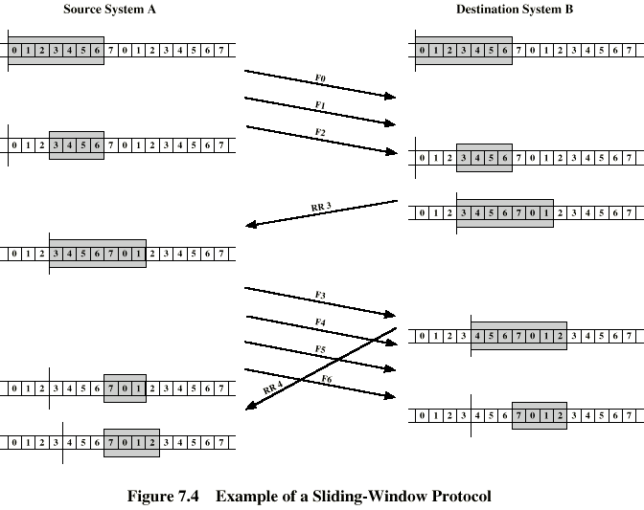
Example Sliding Window

Slide 58
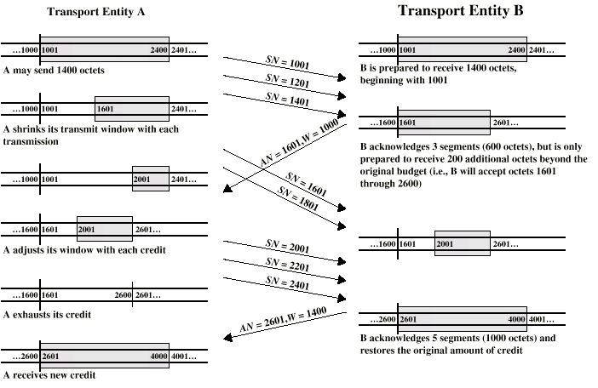
Credit Allocation

Slide 59
Example 24
A TCP connection is using a window size of 10,000 bytes, and the previous acknowledgement number was 22,001. It receives a segment with acknowledgment number 24,001 and window size advertisement of 12,000. Draw a diagram to show the situation of the window before and after.
22.<number>

Slide 60
Example 25
A window holds bytes 2001 and 5000. The next byte to be sent is 3001. Draw a figure to show the situation of the window after the following two events:
An ACK segment with the acknowledgement number 25, 000 and window size advertisement 4,000 is received.
A segment carrying 1000 bytes is sent.
22.<number>

Slide 61
Note
Some points about TCP sliding windows:
❏ The size of the window is the lesser of rwnd and
cwnd.
❏ The source does not have to send a full window’s
worth of data.
❏ The window can be opened or closed by the
receiver, but should not be shrunk.
❏ The destination can send an acknowledgment at
any time as long as it does not result in a shrinking
window.
❏ The receiver can temporarily shut down the
window; the sender, however, can always send a
segment of 1 byte after the window is shut down.
23.<number>

Slide 62
Note
ACK segments do not consume sequence numbers and are not acknowledged.
23.<number>

Slide 63
Note
In modern implementations, a retransmission occurs if the retransmission timer expires or three duplicate ACK segments have arrived.
23.<number>

Slide 64
Note
No retransmission timer is set for an ACK segment.
23.<number>

Slide 65
Note
Data may arrive out of order and be temporarily stored by the receiving TCP,
but TCP guarantees that no out-of-order segment is delivered to the process.
23.<number>

Slide 66

Figure 23.24 Normal operation
23.<number>

Slide 67

Figure 23.25 Lost segment
23.<number>

Slide 68
Note
The receiver TCP delivers only ordered data to the process.
23.<number>

Slide 69

Figure 23.26 Fast retransmission
23.<number>

Slide 70
23-4 SCTP
Stream Control Transmission Protocol (SCTP) is a new reliable, message-oriented transport layer protocol. SCTP, however, is mostly designed for Internet applications that have recently been introduced. These new applications need a more sophisticated service than TCP can provide.
Topics discussed in this section:
SCTP Services and Features
Packet Format
An SCTP Association
Flow Control and Error Control
23.<number>

Slide 71
Note
SCTP is a message-oriented, reliable protocol that combines the best features of UDP and TCP.
23.<number>

Slide 72
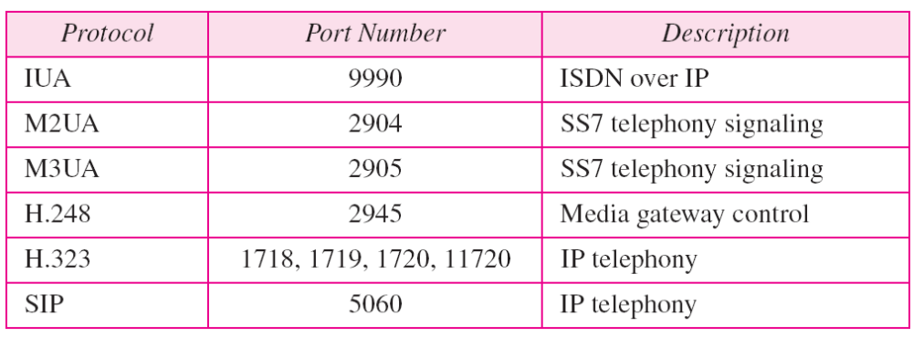
Table 23.4 Some SCTP applications
23.<number>

Slide 73
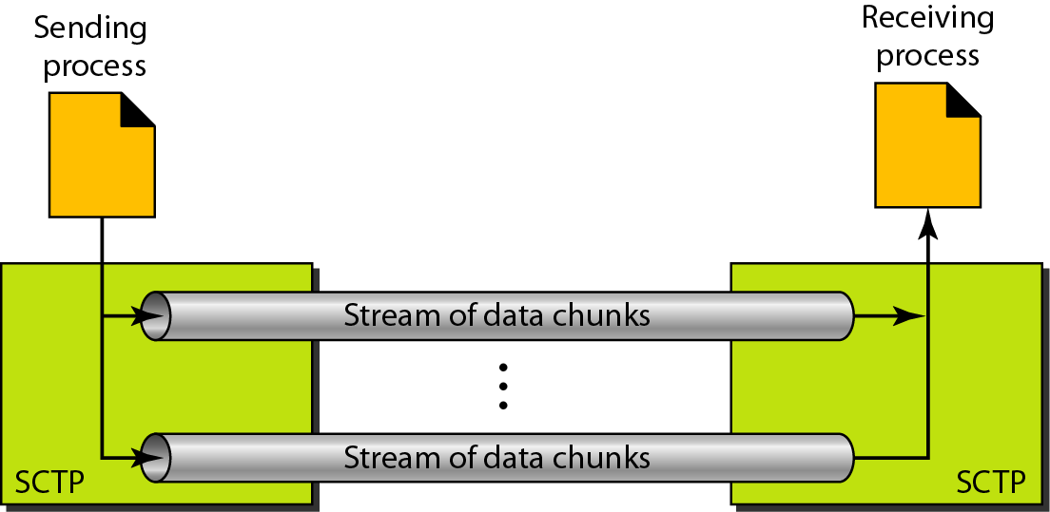
Figure 23.27 Multiple-stream concept
23.<number>

Slide 74
Note
An association in SCTP can involve multiple streams.
23.<number>

Slide 75
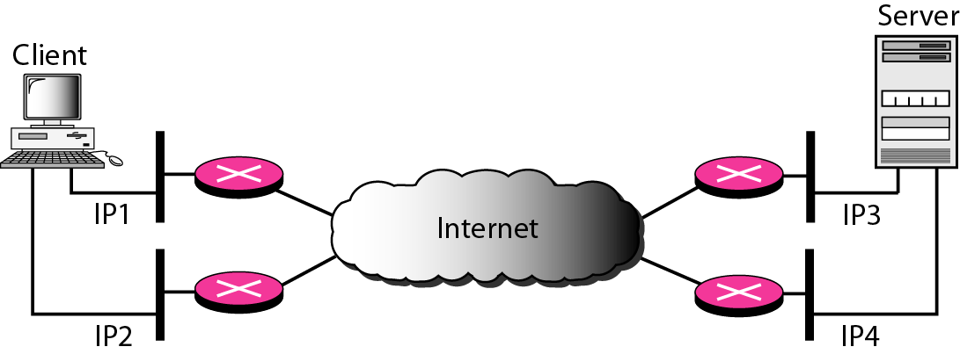
Figure 23.28 Multihoming concept
23.<number>

Slide 76
Note
SCTP association allows multiple IP addresses for each end.
23.<number>

Slide 77
Note
In SCTP, a data chunk is numbered using a TSN.
23.<number>

Slide 78
Note
To distinguish between different streams, SCTP uses an SI.
23.<number>

Slide 79
Note
To distinguish between different data chunks belonging to the same stream, SCTP uses SSNs.
23.<number>

Slide 80
Note
TCP has segments; SCTP has packets.
23.<number>

Slide 81
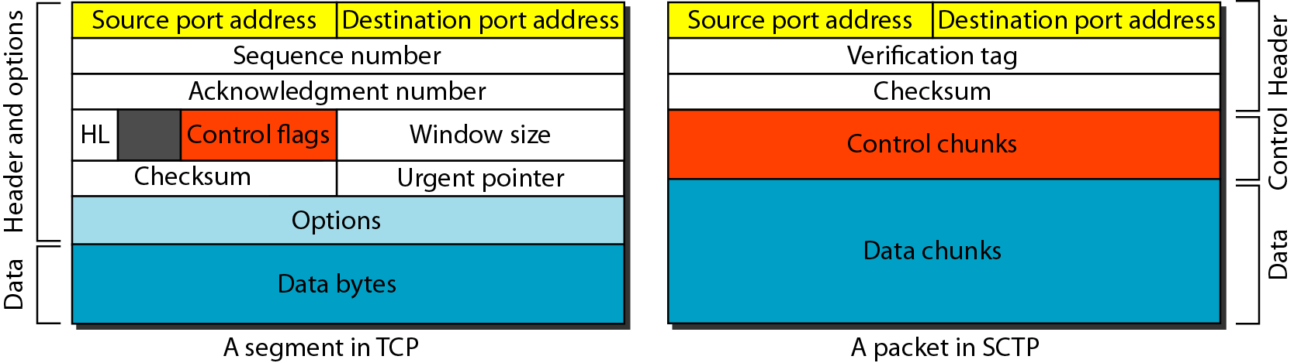
Figure 23.29 Comparison between a TCP segment and an SCTP packet
23.<number>

Slide 82
Note
In SCTP, control information and data information are carried in separate chunks.
23.<number>

Slide 83
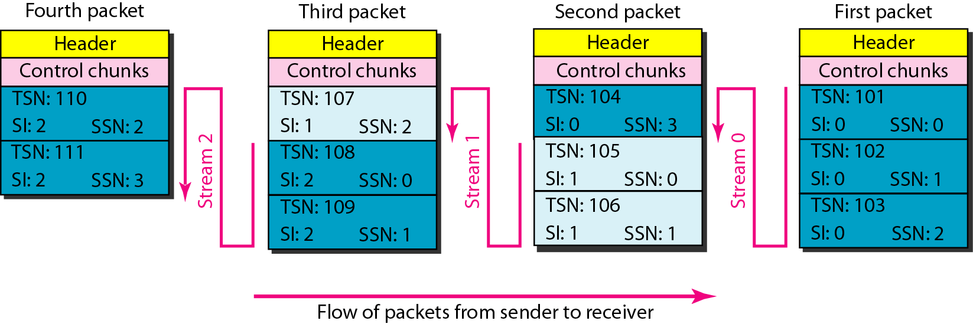
Figure 23.30 Packet, data chunks, and streams
23.<number>

Slide 84
Note
Data chunks are identified by three items: TSN, SI, and SSN.
TSN is a cumulative number identifying the association; SI defines the stream; SSN defines the chunk in a stream.
23.<number>

Slide 85
Note
In SCTP, acknowledgment numbers are used to acknowledge only data chunks;
control chunks are acknowledged by other control chunks if necessary.
23.<number>

Slide 86
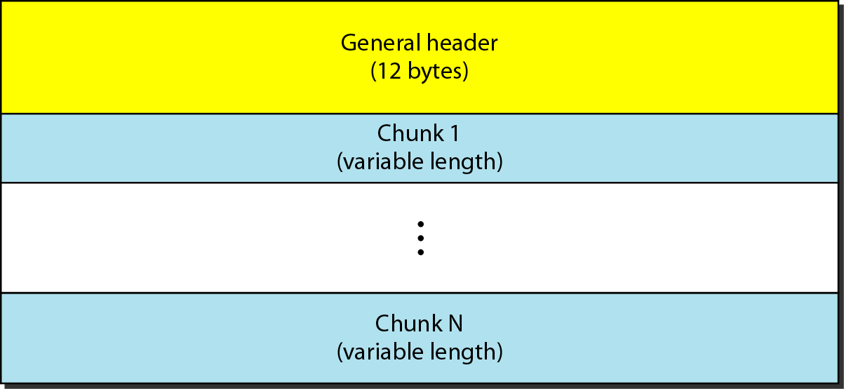
Figure 23.31 SCTP packet format
23.<number>

Slide 87
Note
In an SCTP packet, control chunks come before data chunks.
23.<number>

Slide 88
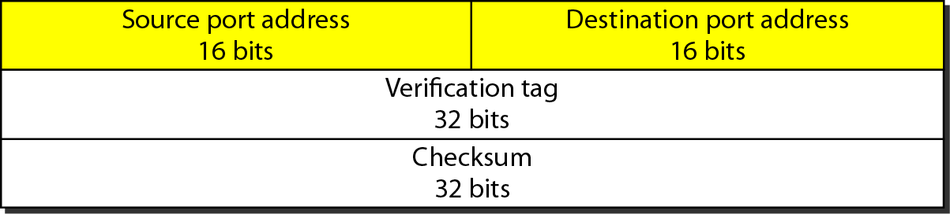
Figure 23.32 General header
23.<number>

Slide 89
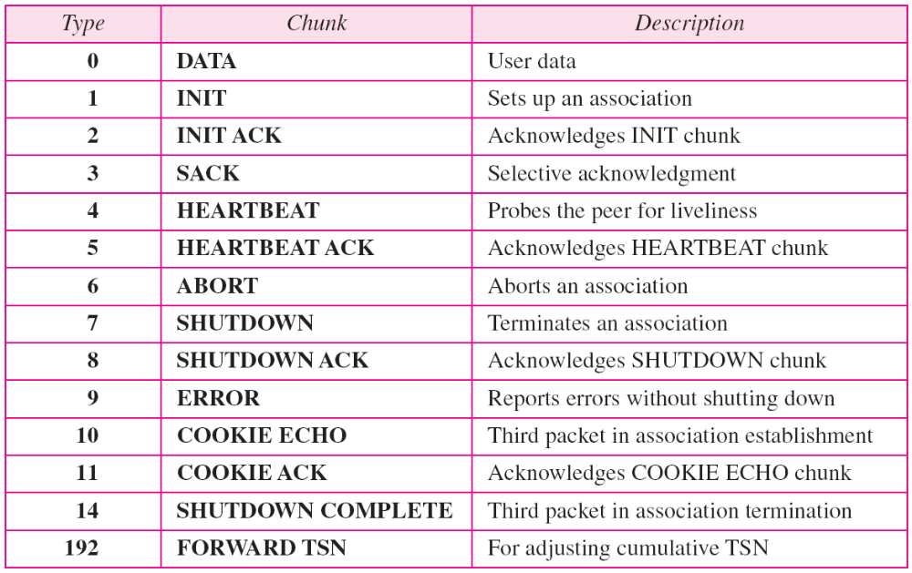
Table 23.5 Chunks
23.<number>

Slide 90
Note
A connection in SCTP is called an association.
23.<number>

Slide 91
Note
No other chunk is allowed in a packet carrying an INIT or INIT ACK chunk.
A COOKIE ECHO or a COOKIE ACK chunk can carry data chunks.
23.<number>

Slide 92
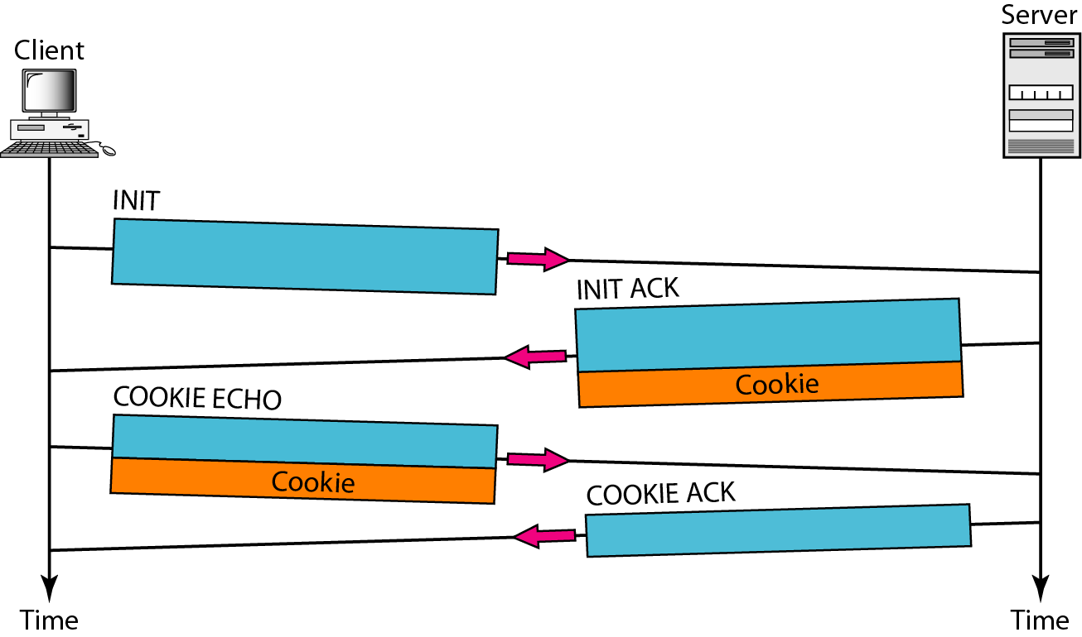
Figure 23.33 Four-way handshaking
23.<number>

Slide 93
Note
In SCTP, only DATA chunks
consume TSNs;
DATA chunks are the only chunks
that are acknowledged.
23.<number>

Slide 94
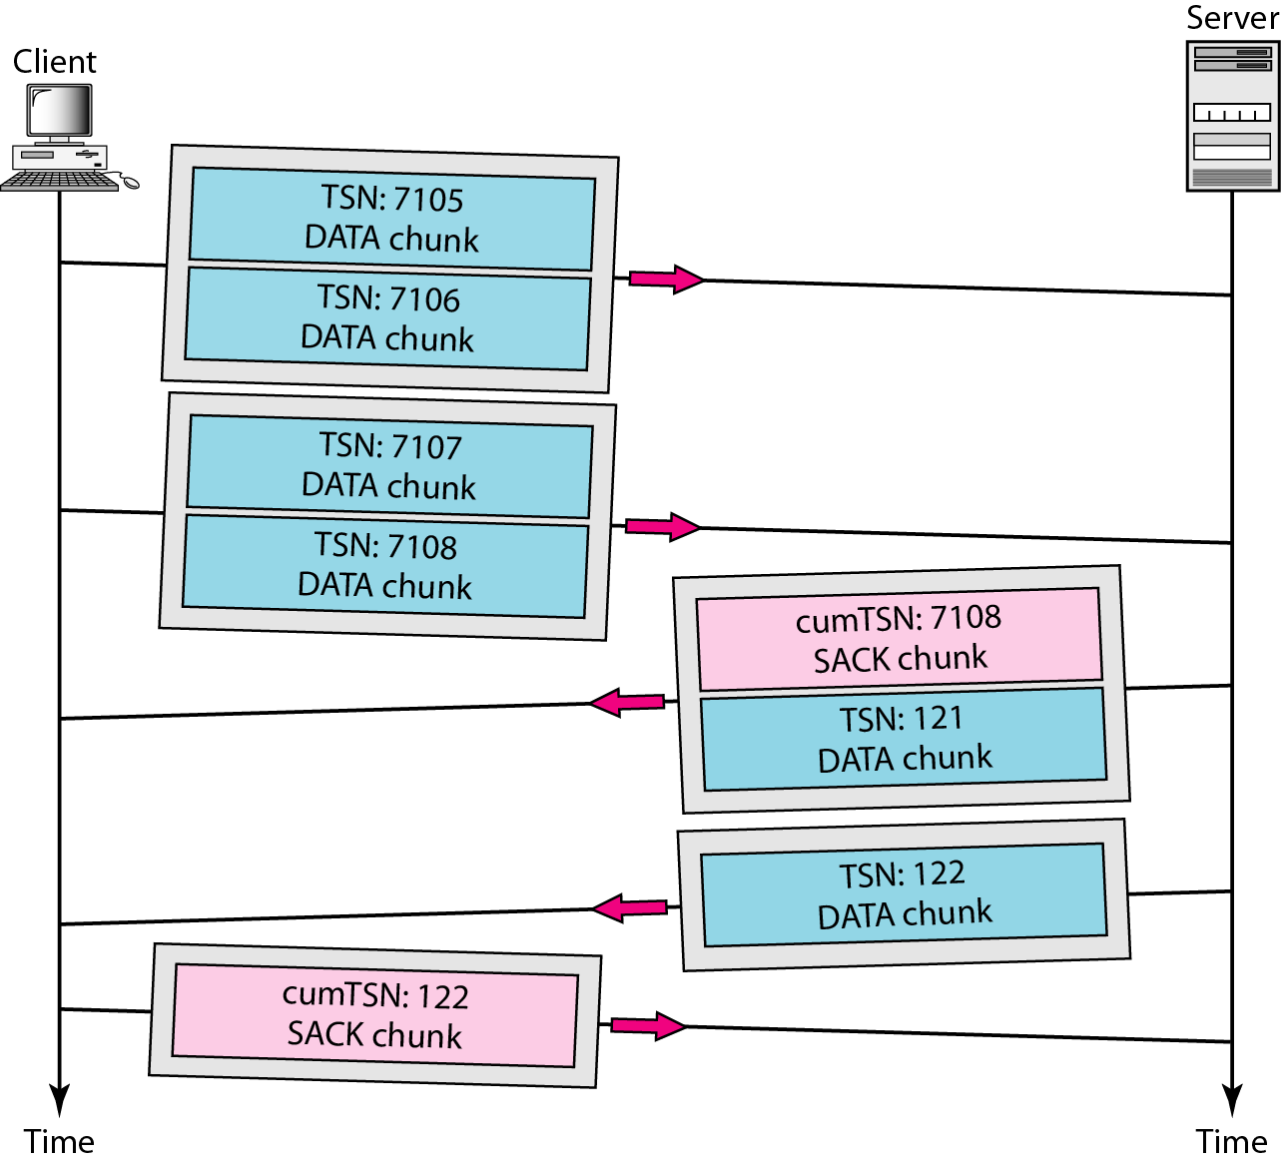
Figure 23.34 Simple data transfer
23.<number>

Slide 95
Note
The acknowledgment in SCTP defines the cumulative TSN, the TSN of the last data chunk received in order.
23.<number>

Slide 96
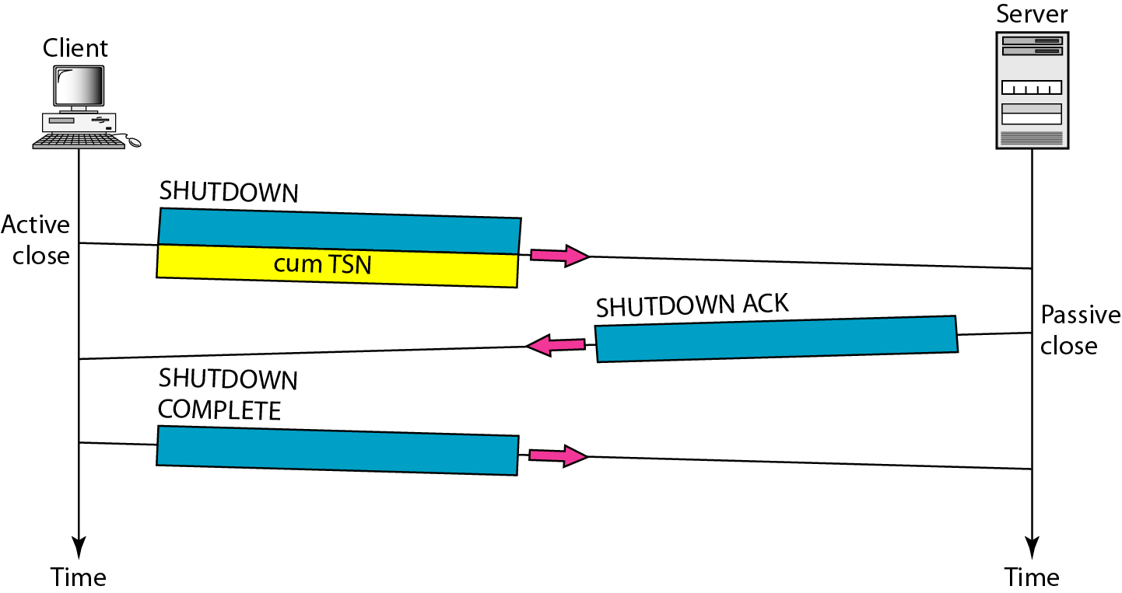
Figure 23.35 Association termination
23.<number>

Slide 97
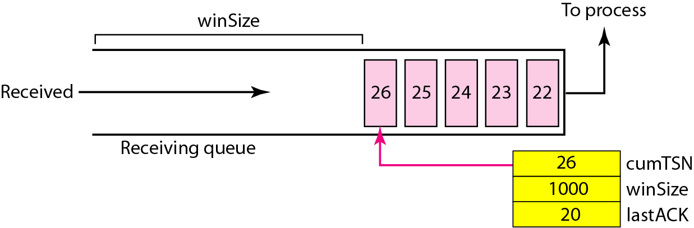
Figure 23.36 Flow control, receiver site
23.<number>

Slide 98
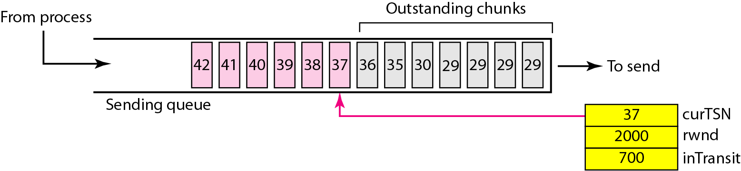
Figure 23.37 Flow control, sender site
23.<number>

Slide 99
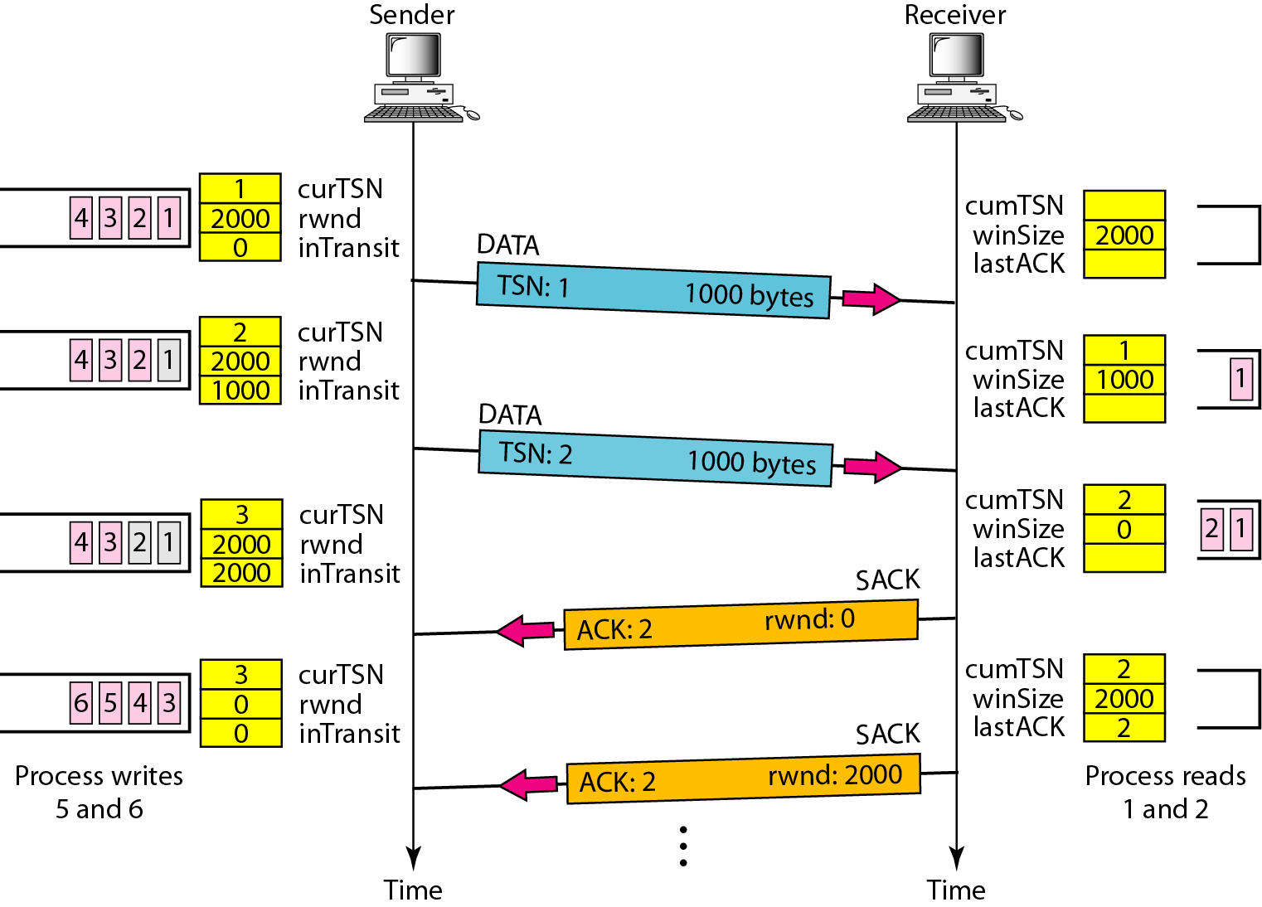
Figure 23.38 Flow control scenario
23.<number>

Slide 100
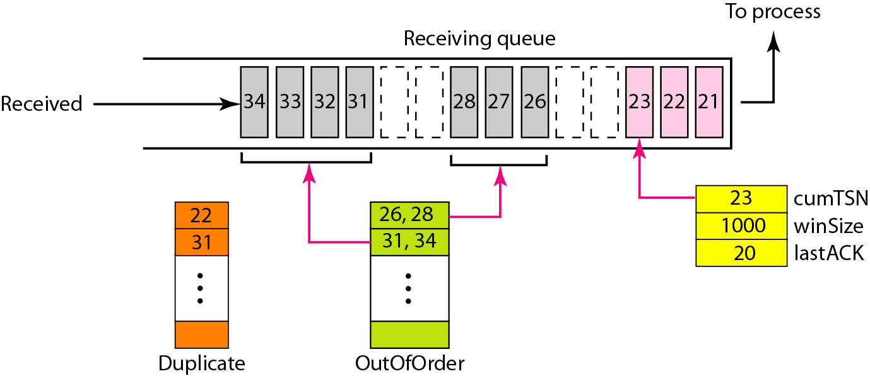
Figure 23.39 Error control, receiver site
23.<number>

Slide 101
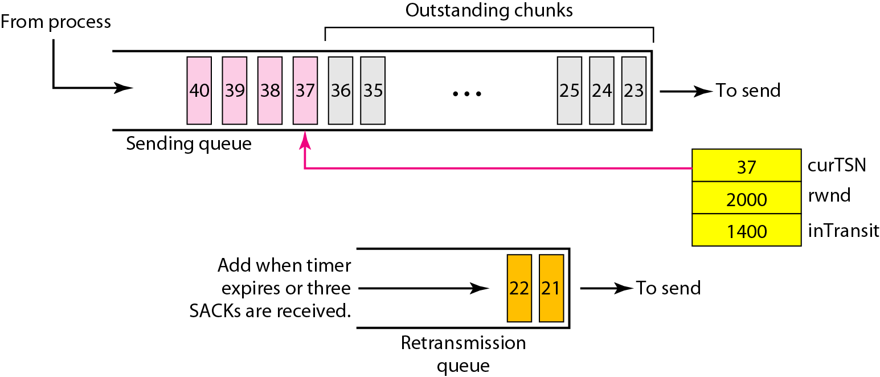
Figure 23.40 Error control, sender site
23.<number>

